Slide 1
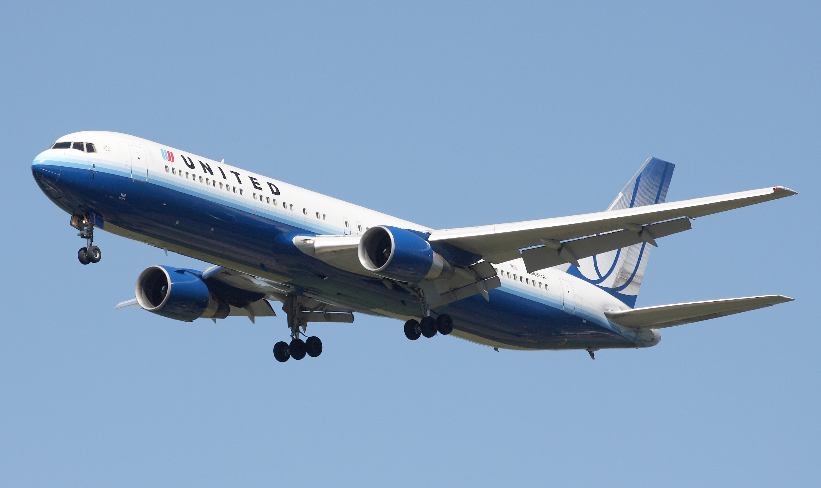
SKY HACK 2024 UNITED AIRLINES
Akshat Agarwal (2K21/CH/08)
Abhishek Choudhary (2K21/ME/16)

Slide 2
TABLE OF CONTENTS
PROBLEM STATEMENT
DATA DESCRIPTION
EXPLORATORY DATA ANALYSIS AND FINDINGS
INSIGHTS AND RECOMMENDATIONS

Slide 3
PROBLEM STATEMENTS
As United Airlines continues its journey to become the best airline in the history of aviation, it is crucial to provide world-class customer service, for which one of the key areas of focus is our call center operations. Call centers play a critical role in ensuring customer issues are resolved quickly and efficiently, but we face challenges in improving metrics such as Average Handle Time (AHT) and Average Speed to Answer (AST).
Your task is to optimize these key call center metrics, helping reduce resolution times and providing faster, more efficient service to our customers. You are required to analyze our existing call center data to identify inefficiencies, determine the drivers of long AHT and AST, and suggest strategies to enhance customer satisfaction, reduce escalations, and improve overall operational efficiency.

Slide 4
Data Description
calls.csv - call_id, customer_id, agent_id, call_start_datetime, agent_assign_datetime, call_end_datetime, call_transcript
customers.csv - customer_id, customer_name, elite_level_code
reason.csv - call_id, primary_call_reason
sentiment_statistics.csv- call_id, agent_id, customer_tone, agent_tone, average_sentiment, silent_percent_average

Slide 5
Data Organization
# Merge callsDF and reasonsDF on 'call_id' to get call reasons into the main DataFrame
mergedDF = pd.merge(callsDF, reasonsDF, on='call_id')
# Now merge with sentimentsDF (assuming it has 'call_id')
mergedDF = pd.merge(mergedDF, sentimentsDF, on='call_id', how='left')
# Now merge with customerDF (assuming it has 'customer_id')
mergedDF = pd.merge(mergedDF, customerDF, on='customer_id', how='left')
Convert relevant columns to datetime format
mergedDF['call_start_datetime'] = pd.to_datetime(mergedDF['call_start_datetime'])
mergedDF['call_end_datetime'] = pd.to_datetime(mergedDF['call_end_datetime'])
mergedDF['agent_assigned_datetime'] = pd.to_datetime(mergedDF['agent_assigned_datetime'])

Slide 6
Average Handle Time (AHT): 1134.1488005041033 seconds Average Speed to Answer (AST): 436.97207927625163 seconds Most Frequent Call Reason: irrops with AHT: 1145.20 seconds Least Frequent Call Reason: unaccompanied minor with AHT: 1207.50 seconds Percentage difference in AHT between most and least frequent call reasons: -5.16%
AHT by Agent Tone: AHT by Customer Tone: agent_tone customer_tone angry 814.262295 angry 1131.011909 calm 1071.050607 calm 1139.023949 frustrated 1043.647469 frustrated 1128.753119 neutral 1184.098972 neutral 1143.635278 polite 685.185185 polite 1128.279466

Slide 7
Exploratory Data Analysis
Average Handle Time (AHT) during high volume periods: 1132.57 seconds Average Speed to Answer (AST) during high volume periods: 437.34 seconds
Average Handle Time (AHT) by Call Type: primary_call_reason checkout 1741.557203 etc 1507.184874 post-flight 1502.327945 mileage plus 1356.588617 voluntary cancel 1261.381456
Average Handle Time (AHT) by Agent Tone: agent_tone neutral 1184.098972 calm 1071.050607 frustrated 1043.647469 angry 814.262295 polite 685.185185
Average Handle Time by Call Type during High Volume: primary_call_reason checkout 1778.205882 post-flight 1484.320298 etc 1395.176471 mileage plus 1374.474041 voluntary cancel 1255.392491
Average Handle Time by Agent Tone during High Volume: agent_tone neutral 1181.788496 calm 1066.199209 frustrated 1063.201893 polite 837.142857 angry 818.769231

Slide 8
Exploratory Data Analysis
Average Speed to Answer (AST) by Agent Tone during High Volume: agent_tone polite 497.142857 calm 443.732470 neutral 434.702828 frustrated 426.813880 angry 426.000000
Average Speed to Answer (AST) by Call Type during High Volume:
primary_call_reason checkout 723.882353 traveler updates 690.000000 unaccompanied minor 682.285714 seating 571.202068 post-flight 568.864060

Slide 9
Exploratory Data Analysis
Call Reasons with Low Sentiment and High AHT: primary_call_reason average_aht average_sentiment call_count 3 checkout 1741.557203 -0.069030 1888 4 communications 1066.687500 -0.036392 3840 5 irrops 1145.197205 -0.074065 13311 6 mileage plus 1356.588617 -0.027398 5851 7 post-flight 1502.327945 -0.063914 4330 8 products & services 1049.009604 -0.034430 3332 9 seating 1045.819324 -0.002770 6365 11 voluntary cancel 1261.381456 -0.031512 1607 12 voluntary change 1179.640487 -0.003826 10848

Slide 10
Proposed Improvements
Proposed IVR Improvements:
Booking Issues: Enhance IVR options to allow customers to modify or cancel bookings through self-service.
Mileage Plus Inquiries: Provide an IVR option to check Mileage Plus status and points balance.
Flight Status Updates: Implement an option to check flight status via IVR without needing to speak to an agent.
Change Flight Requests: Allow customers to change their flights through the IVR system to reduce call volume.
Booking Issues:
Improvement: Enhance IVR options to allow customers to modify or cancel bookings through self-service. Reasoning: Many customers call for booking modifications or cancellations. Allowing these tasks to be done via IVR can significantly reduce call volume. Mileage Plus Inquiries:
Improvement: Provide an IVR option to check Mileage Plus status and points balance. Reasoning: Frequent inquiries about mileage status can be easily resolved with automated responses, thus freeing agents for more complex inquiries. Flight Status Updates:
Improvement: Implement an option to check flight status via IVR without needing to speak to an agent. Reasoning: Customers often call to inquire about flight statuses. An IVR option could provide real-time updates without involving an agent. Change Flight Requests:
Improvement: Allow customers to change their flights through the IVR system to reduce call volume. Reasoning: Changes to flights are common requests and could be streamlined through a more robust IVR system. Voluntary Cancel:
Improvement: Introduce an IVR self-service option specifically for customers who wish to cancel their flights. Reasoning: This would provide a dedicated self-service channel for customers looking to cancel flights, reducing the burden on agents. Voluntary Change:
Improvement: Enhance IVR capabilities to enable customers to easily change their flight details directly through the system. Reasoning: Enabling self-service for voluntary changes would alleviate the number of calls directed to agents for this purpose, improving overall efficiency.

Slide 11
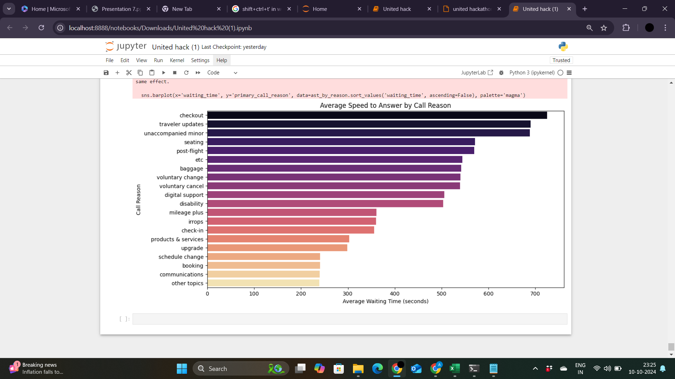
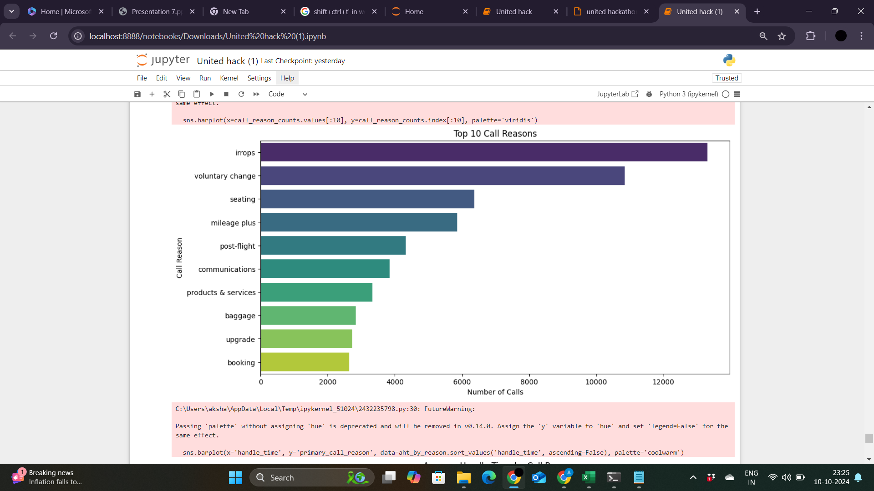
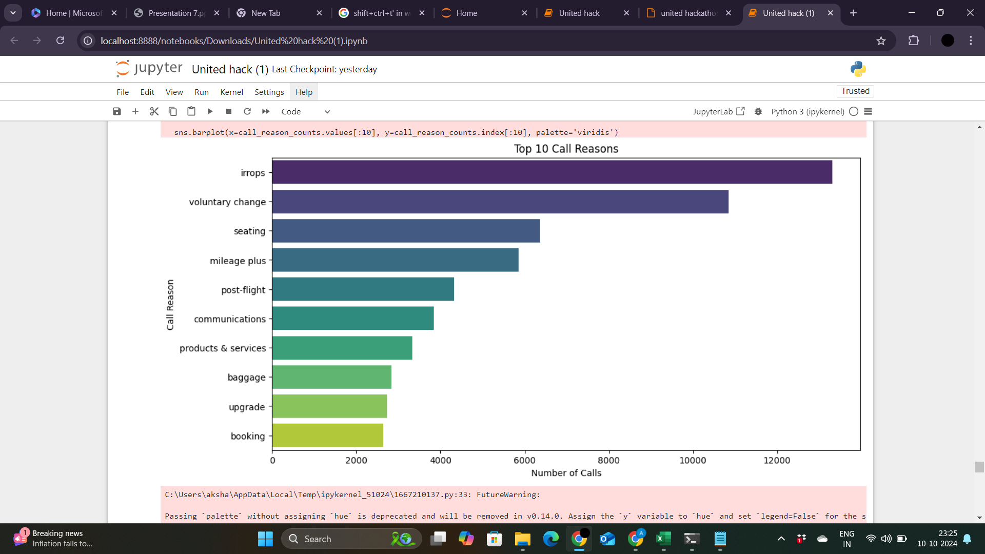
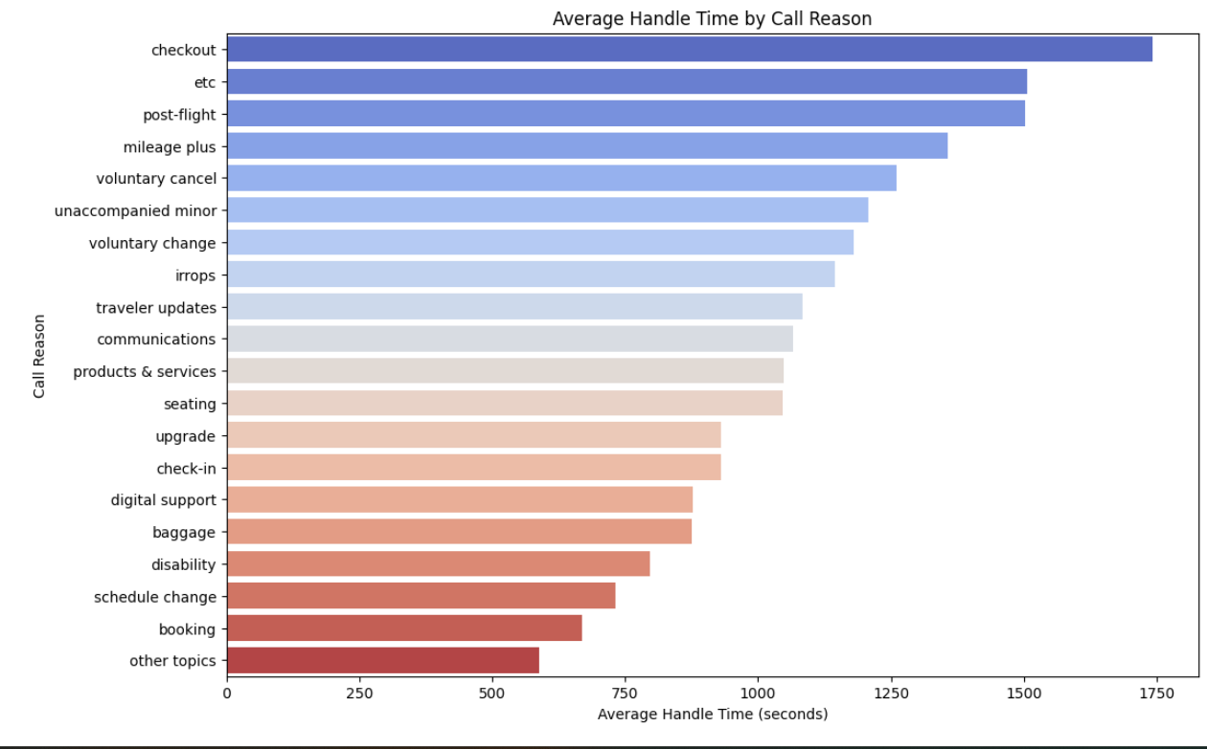
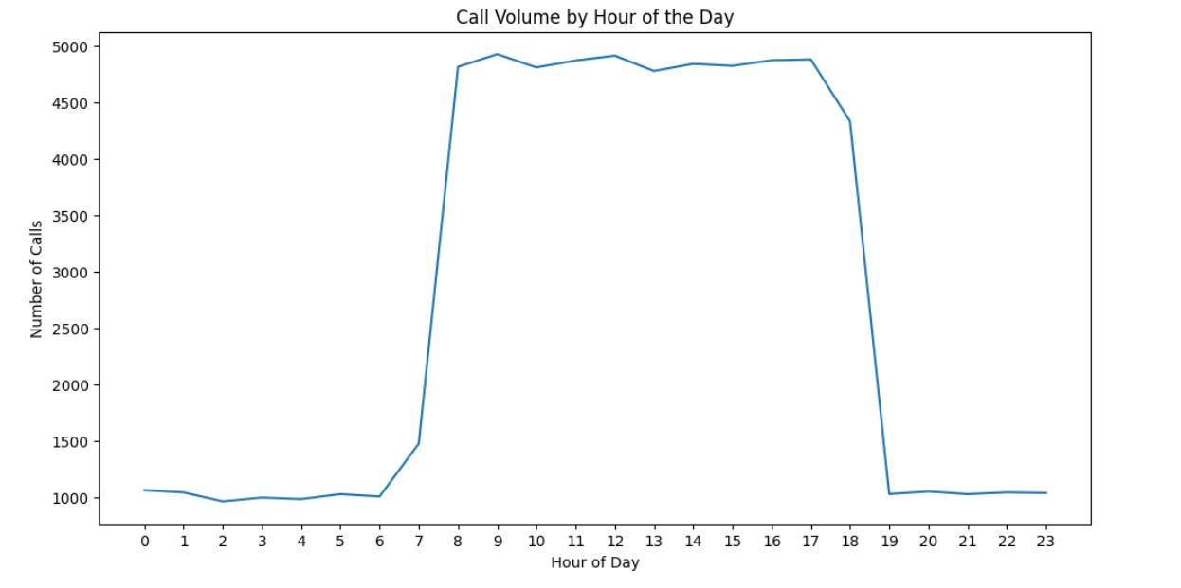

Slide 12
THANK YOU

